Slide 1
Supervised Dictionary Learning
1.Bhagyashree Narayan Shinde
2. Satyanarayana Gokavarapu

Slide 2
Purpose
Sparse signal models
Learning discriminative sparse models
Supervised dictionary learning generative/discriminative framework using sparse models.

Slide 3
Introduction
Sparse and overcomplete models
Efficiency of sparse models.
Why choose sparse over overcomplete models?
Sparse dictionary learning framework.

Slide 4

Supervised Dictionary Learning
Sparse Coding
we have signal x in R ^n
Dictionary D=[d1,d2,…,dk] in R where R has dimensions n x k
Initially k >n
Sparse coding with l1 regularization
(1)
Reconstruction error
Sparsity penalty

Slide 5

Continued
Models for classification task using sparse code
1. Linear(α)
2. Bilinear(x, α)
1. Linear(α)
2. Bilinear
Adapting dictionary D to data given, we solve
(2)

Slide 6


Continued
Equation 2 provides us sparse codes αi for every signal xi using reconstructive approach.
Sparse codes are used as posterior in logistic regression used for classifying in the framework.
where C = logistic loss function C(x) = log( )
In order to achieve our goal of learning jointly dictionary D and θ , the following formula is proposed
λ0 = controls significance of reconstruction term
loss( xi , yi) =
where
(3)
(4)
(5)

Slide 7


Continued
Hence supervised sparse coding for classification of signal x with unknown label y, given learned dictionary D and parameters
Proceeding with more discriminative approach in order to get
> >
Hence,
As we see equation 7 is more difficult to solve than equation 4 , mixed formulation between minimization of the generative and discriminative version of it is adopted
(6)
(7)
(8)

Slide 8

Model Interpretation (Linear Model)
Linear Model has probabilistic interpretation
Graphical Model providing probabilistic interpretation while using linear model with no bias to coefficient :
Gaussian on w ,
constraint on D is
αi with Laplace prior
Generative training – finds maximum likelihood estimates of D and w based on Joint distribution
Discriminative training – maximum of

Slide 9
Model Interpretation (Bilinear model)
Bilinear model :
Bilinear model can be interpreted in terms of kernel instead of probabilistic interpretation
We have Kernel K:
Above kernel is product of two linear kernels, one on α and input signal x
Raina et in ICML 2007 ‘Self-taught learning: transfer learning from unlabeled data ‘ learn a dictionary adapted to reconstruction on a training set, then train an SVM a posteriori on the decomposition coefficients.

Slide 10

Optimization
Problem : Learning a reconstructive dictionary D
For optimization procedure equation 4 is written as below:
Block coordinate iterates between two problems which are supervised sparse coding and supervised dictionary update.
To solve discriminative version of supervised dictionary learning a continuation method has been chosen which starts from generative and ends with discriminative.

Slide 11
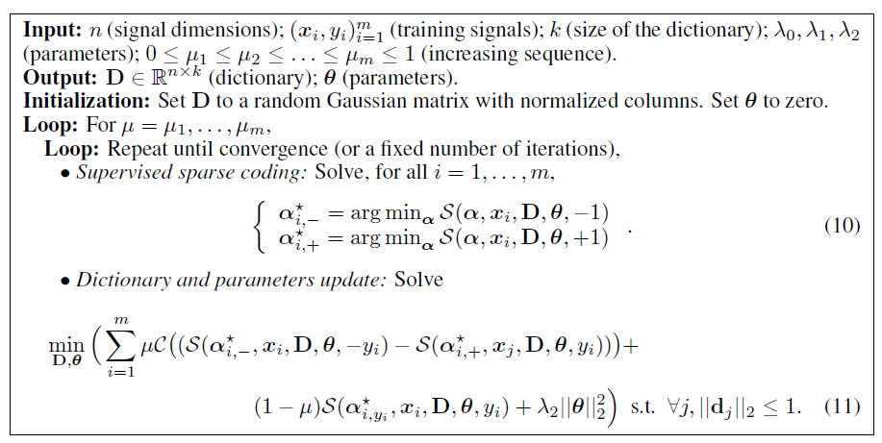
Supervised Sparse Coding

Slide 12

Continued ..
We wan to minimize the convex function (g) which requires ∇g and bound on spectral norm of it’s hessian Hg

Slide 13
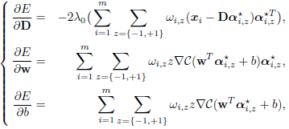
Dictionary Update
Problem : Updating D and θ in equation 11
Using projected gradient descent to get local minimum of E(D, θ)
We take partial derivatives of E(D, θ) for equation 11 with respect to D and θ we get
where
(12)

Slide 14
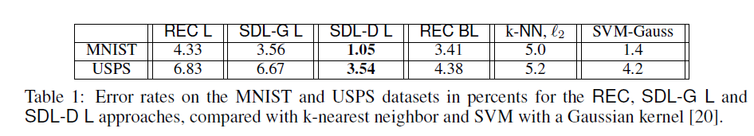
Experimental Validation
Below are the model parameters
λ0, λ1, λ2, μ and k
K= λ1/ λ0 (sparsity parameter)
λ2 – regularization parameter avoiding overfitting. Can be calculated using cross – validation
Λ0 – tradeoff parameter. Steps for finding λ0 are as follows:
Perform cross validation for few iterations with μ = 0 to get good value for SDL – G
we calculate a scale factor γ⋆ such that
iii. After a supervised sparse coding step, we compute the best scale factor γ⋆, and replace λ0 and λ1 by γ⋆λ0 and γλ1
Reconstructive tasks | K = 256
Discriminative tasks | K=32 or k= 64

Slide 15
Digits Recognition
The purpose of our second experiment is not to measure the raw performance of our algorithm, but to answer the question “are the obtained dictionaries D discriminative per se?”. To do so, we have trained on the USPS dataset 10 binary classifiers, one per digit in a one vs all fashion on the training set.
To find answer to question above we follow steps below:
Discard learned parameters and use learned dictionaries from reconstructive model.
For every dictionary decompose each image of training set by solving equation 1 for each of them.
Repeating sparse decomposition on test set allows us to evaluate performance of learned SVMs
Plotting error rate ( In figure 3)

Slide 16
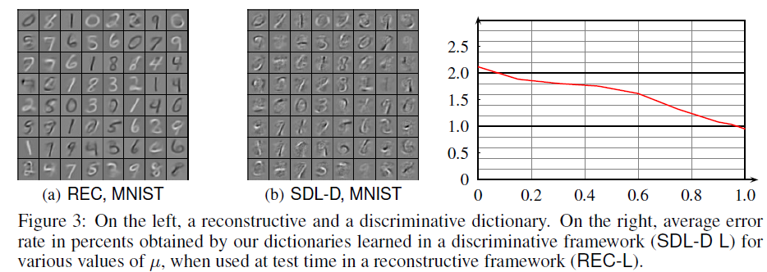
It can be observed from the graph above that dictionaries obtained with discriminative learning improves performance significantly of basic linear classifier.

Slide 17
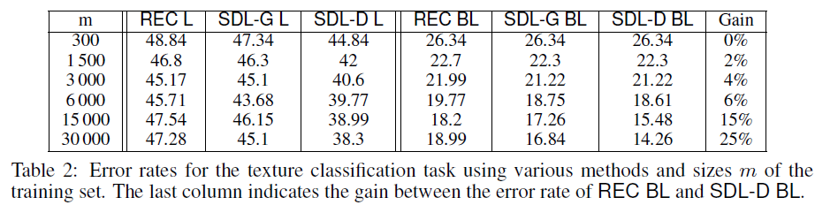
Texture Classification
We observed that linear model works better than bilinear.
Reason : simplicity of task
Now our next question is “ when is BL worth using ? ”
To find an answer to above question we follow steps below :
Initially we choose two images from Brodatz dataset
We build two classes for these images compose of 12 x 12 patches taken from those two textures
Comparison is made for classification performance of all methods for dictionary of size k = 64 and κ = 0.15.

Slide 18
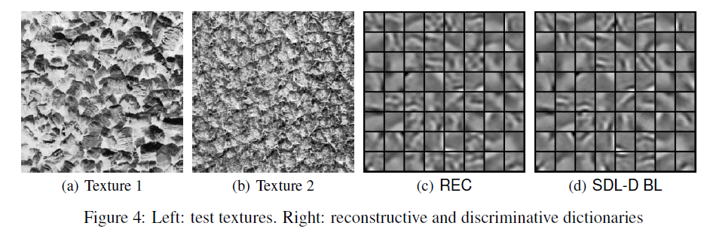

Slide 19
Conclusion
A discriminative approach to supervised dictionary learning has been successfully introduced which efficiently exploits the exploits the corresponding sparse signal decompositions in image classification tasks
An effective method have been proposed for learning a shared dictionary multiple models such as linear or bilinear

Slide 20
Future Scope
Future work will be in direction of adapting the proposed framework to shift-invariant models that are standard in image processing tasks, but not readily generalized to the sparse dictionary learning setting.
Moreover investigation is extended to unsupervised and semi-supervised learning and applications to natural image classification.

Slide 21
Thankyou

Slide 22


